Slide 1
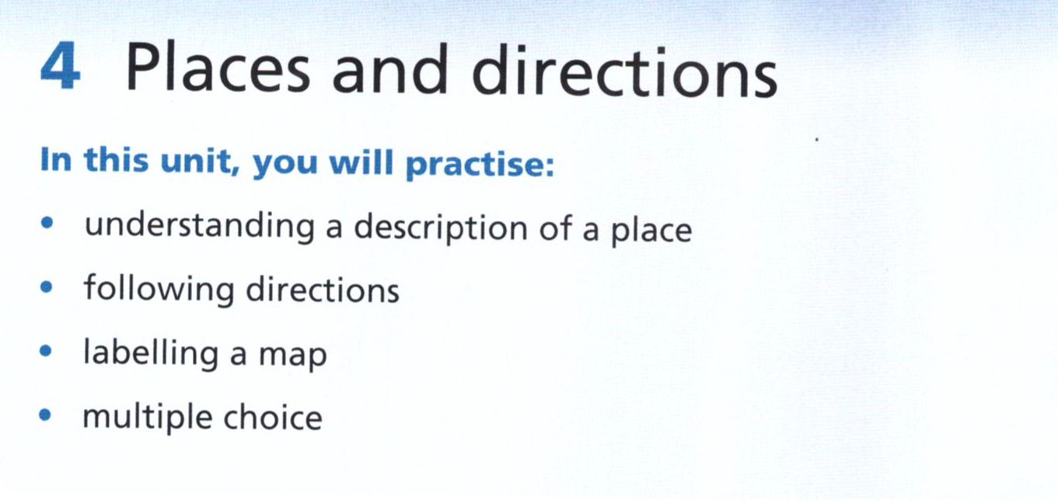

Slide 2
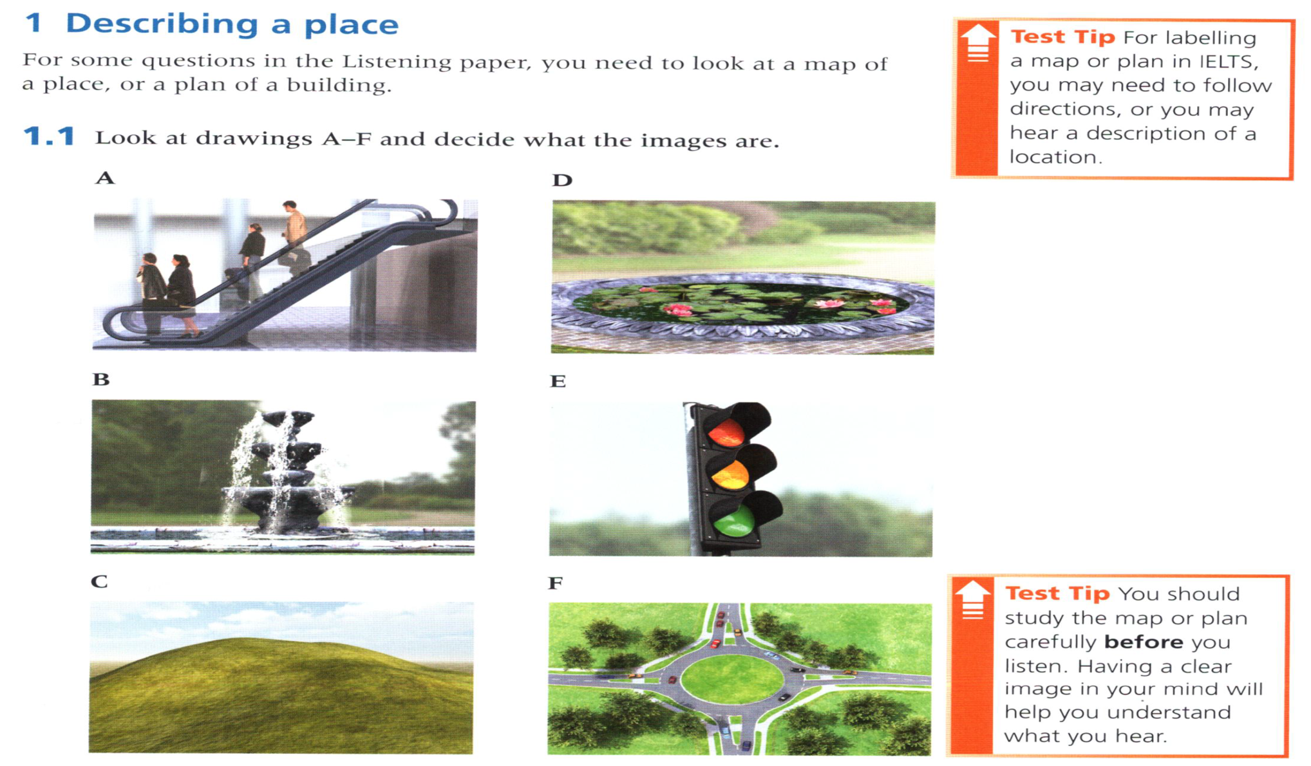
an escalator
a pond
a fountain
traffic lights
a hill
a roundabout

Slide 3
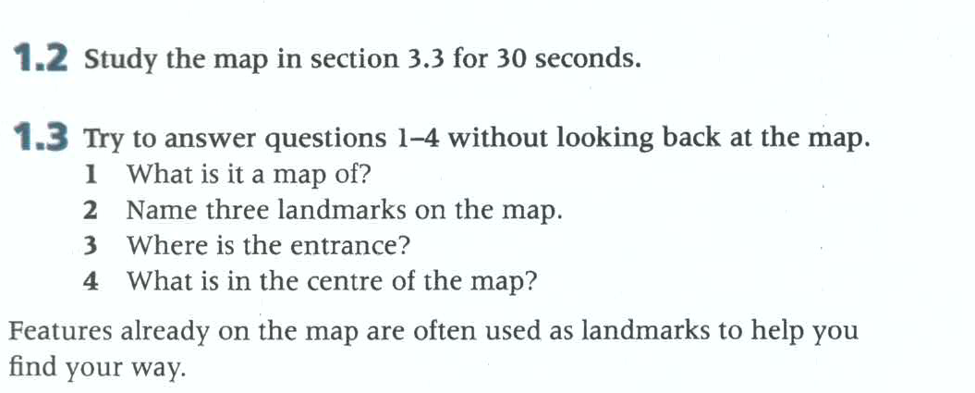
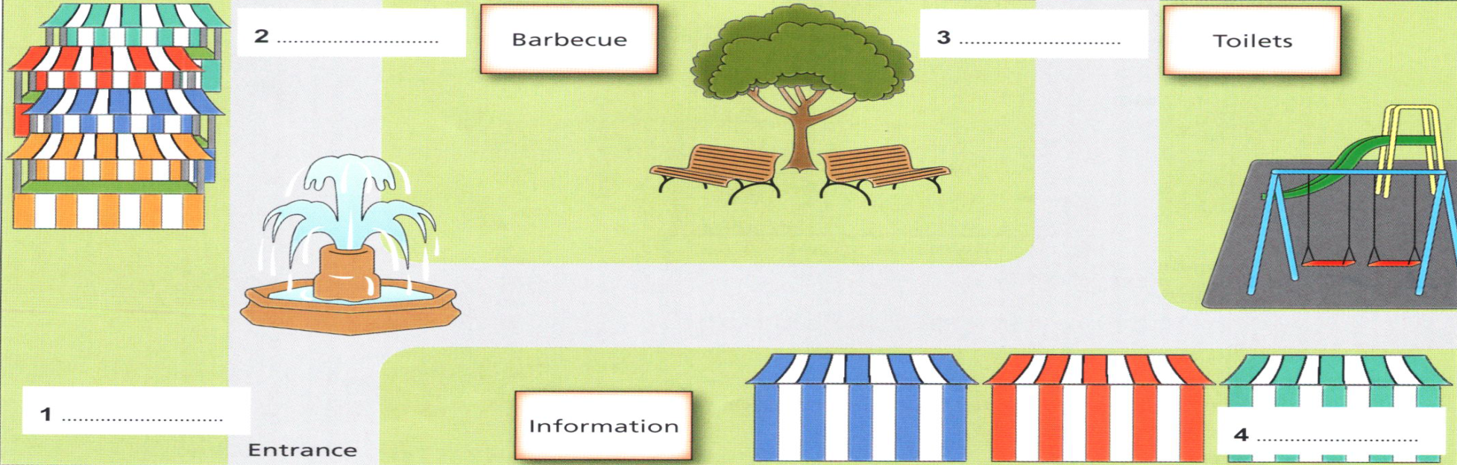
a market
a tree, a fountain, a play area (swings)
at the bottom on the left
a tree

Slide 4
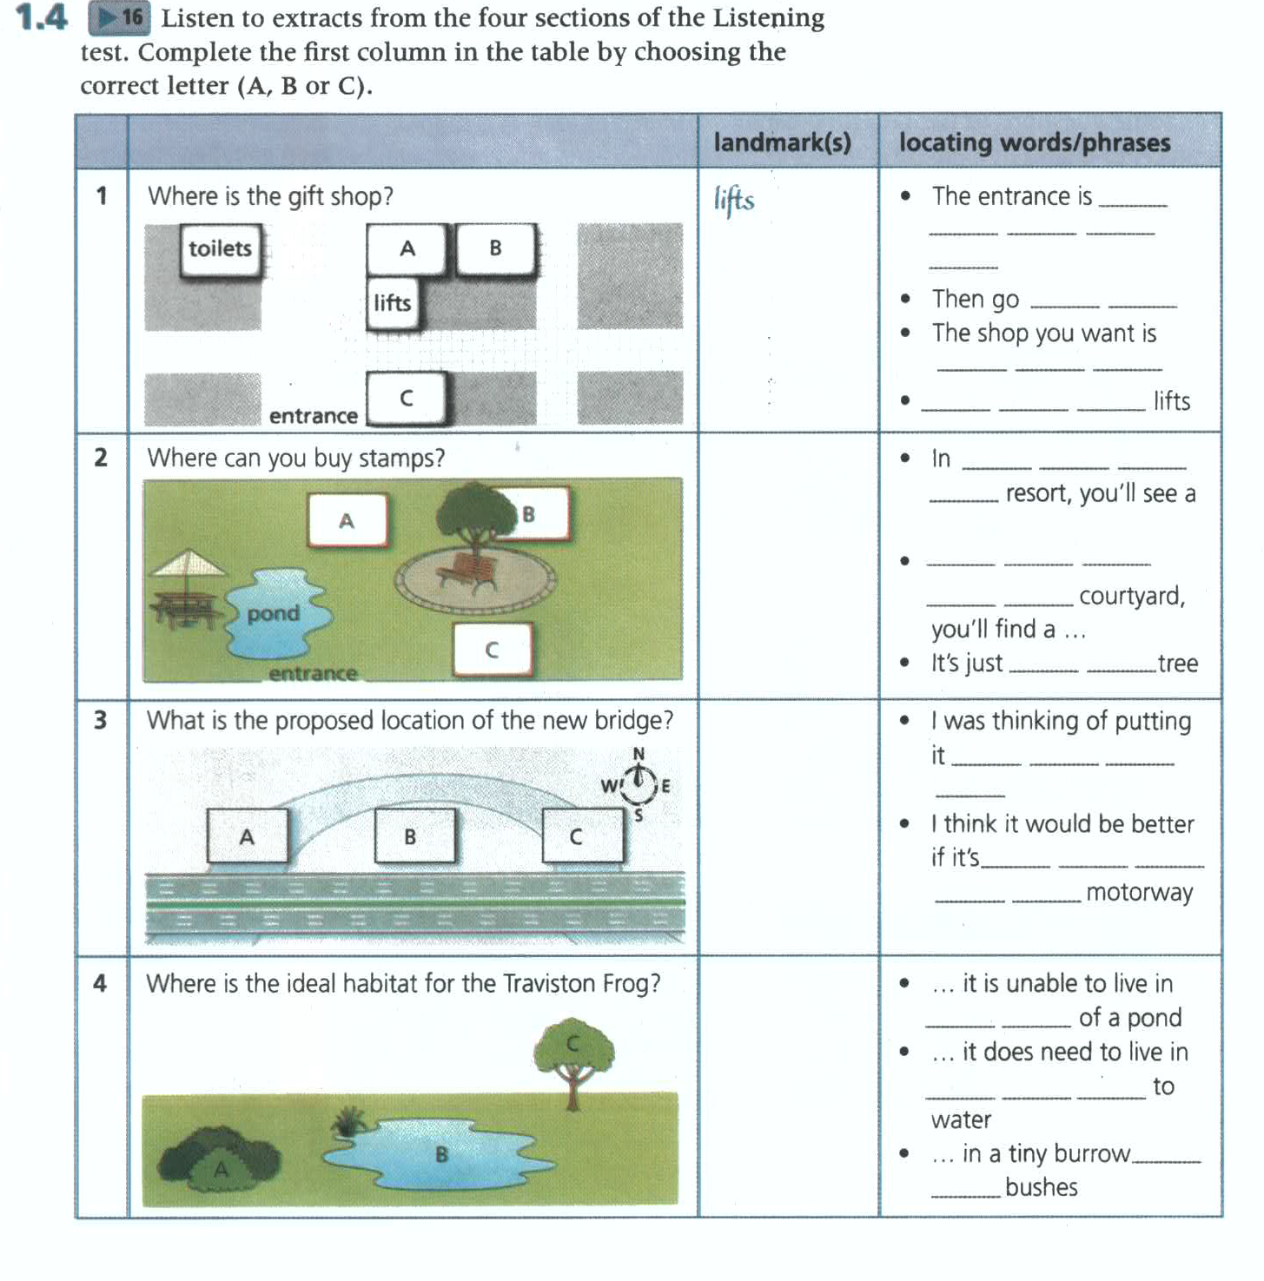
16
over there on your left
entrance, toilets
straight ahead
opposite the toilet
Next to the
circular, courtyard, entrance, tree
the middle of the
To the right of the
behind the
river, motorway
right in the middle
at the eastern end of the
bushes, pond, tree
in the area
fairly close proximity
surrounded by

Slide 5
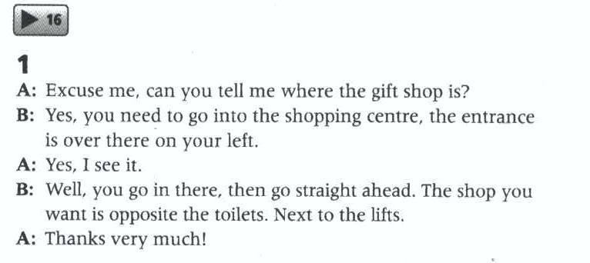
16

Slide 6
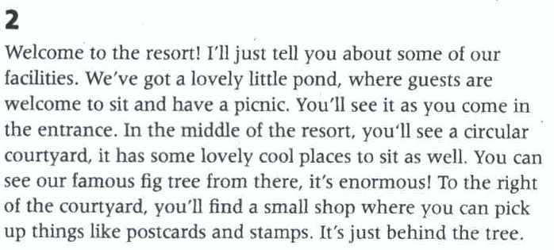

Slide 7
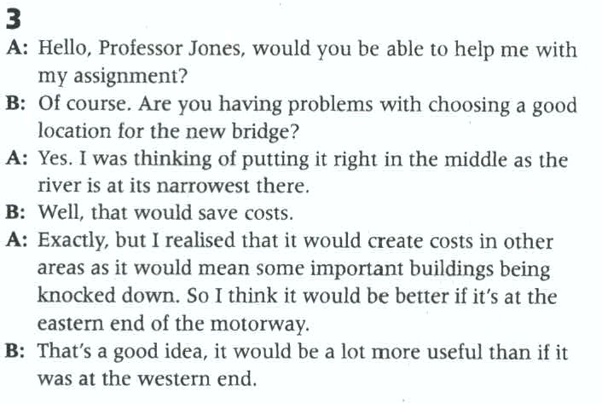

Slide 8
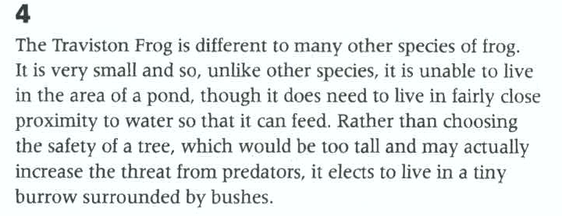

Slide 9
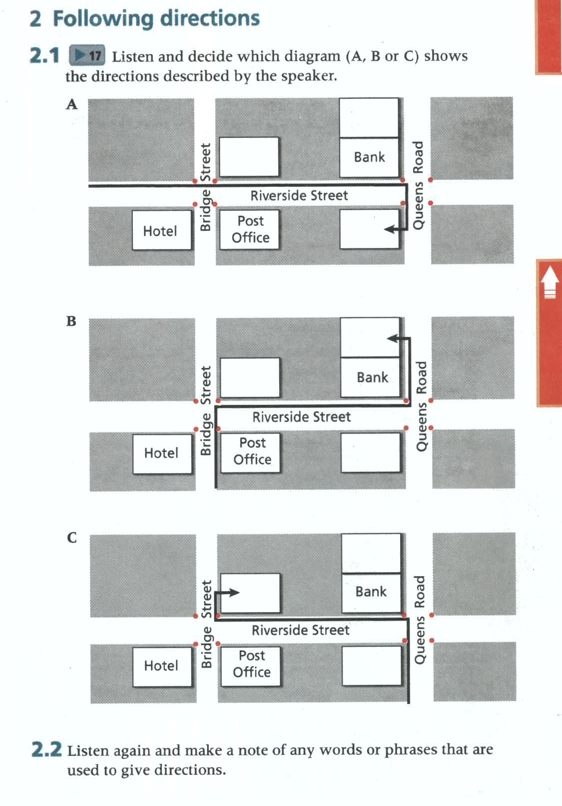
17

Slide 10
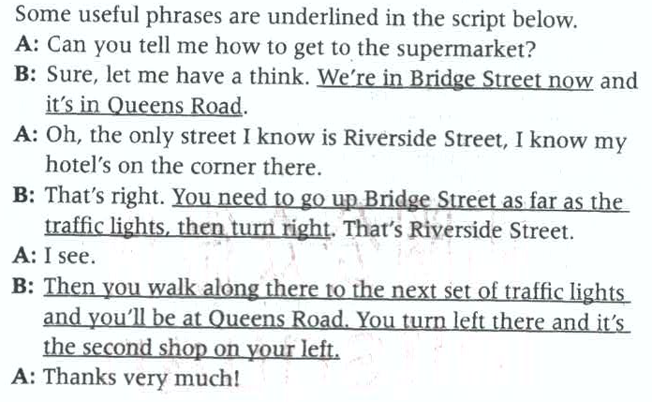
17

Slide 11
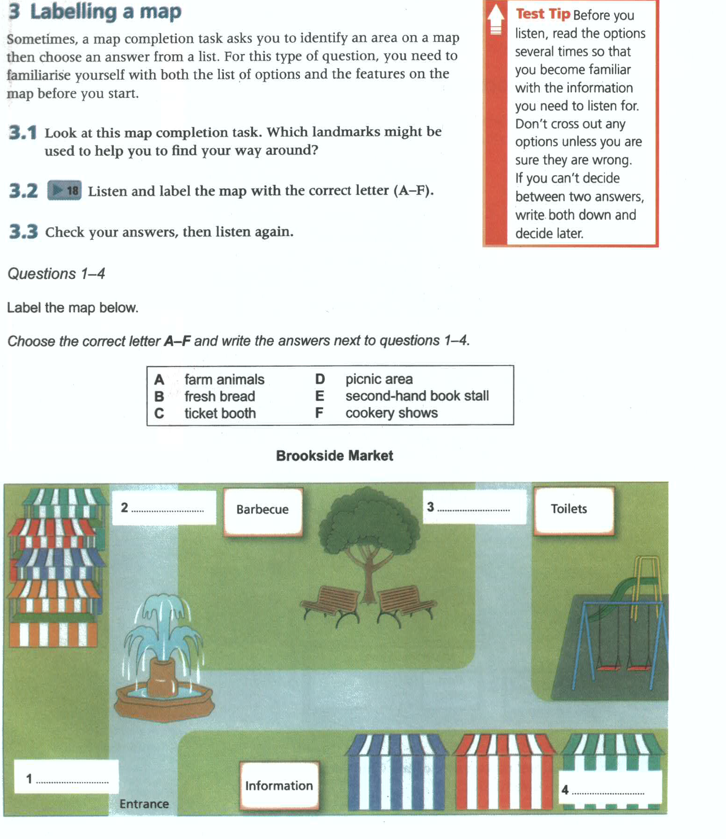
18
3.1 useful landmarks: information, the entrance, the toilets, the barbecue, the tree and the playground
B
D
F
A

Slide 12
18
Listen again and follow the clues to take notes.
Information stand, to the right of entrance
Parking, free
Ticket booth, now stage, cookery demo
50 stalls, no books, no second hand
Famous baker, early to buy his produce, at the back next to barbecue
Special area, own lunch, near tree in the middle
Toilet, same
Market, next to circus school
Play ground, on the right hand side

Slide 13
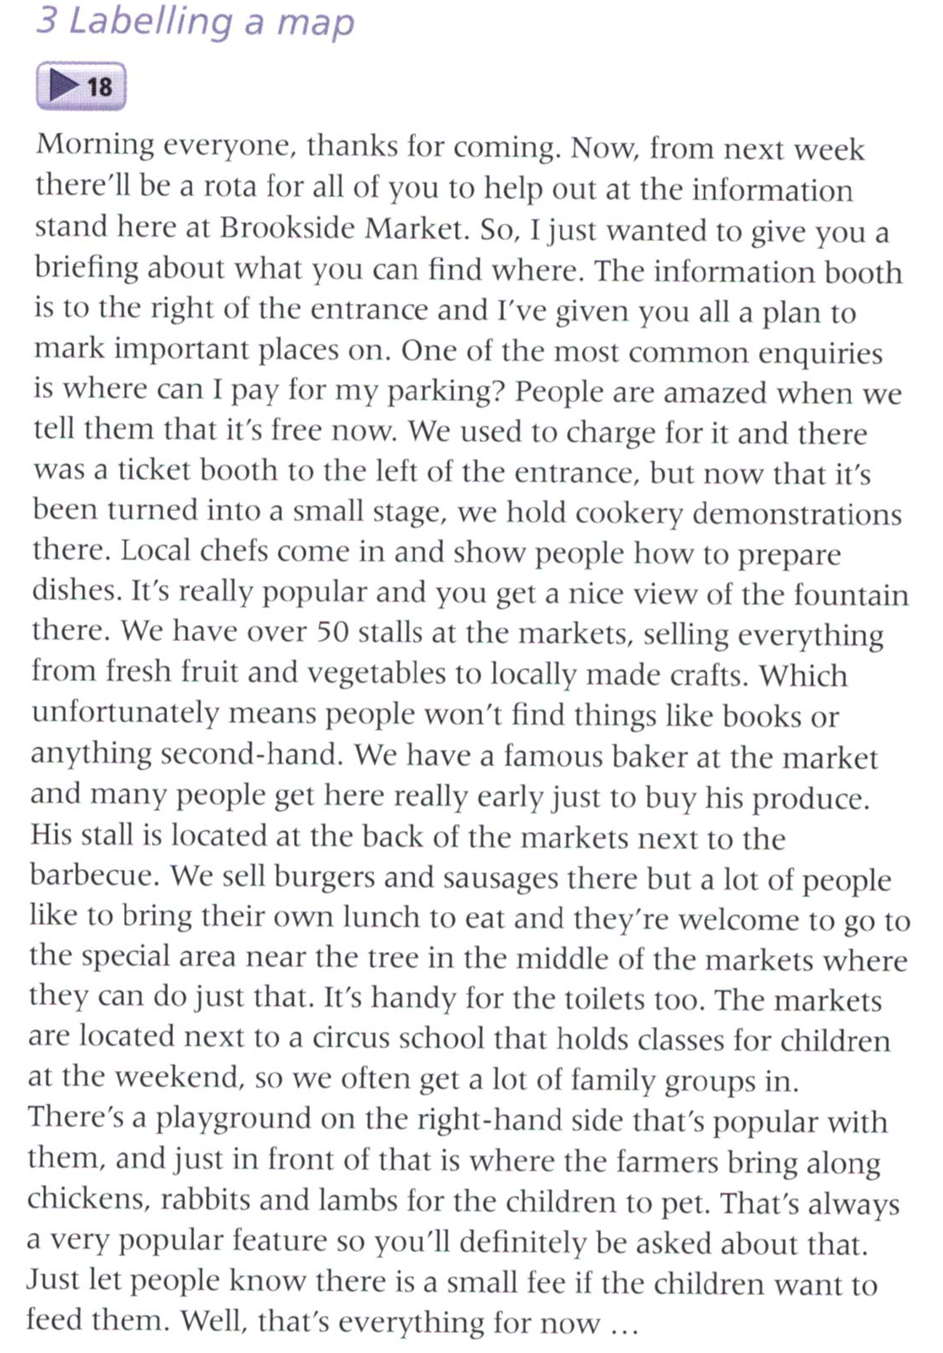
18

Slide 14
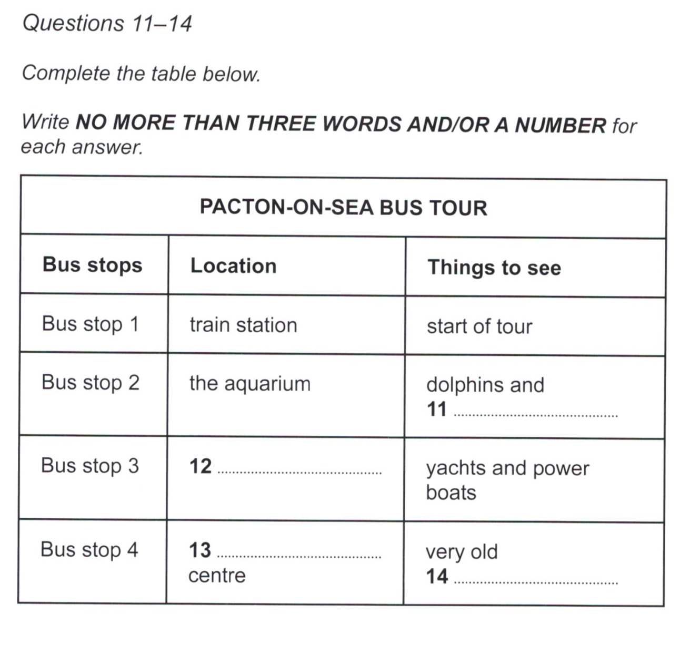
40-1
Other information
Reasonably priced
sharks
Stroll along waterfront, some old, but most modernized, now harbor
old fishing village/
Old Fishing Village
shopping
Morning, quiet, afternoon, busy, pics taken
(water) fountain

Slide 15
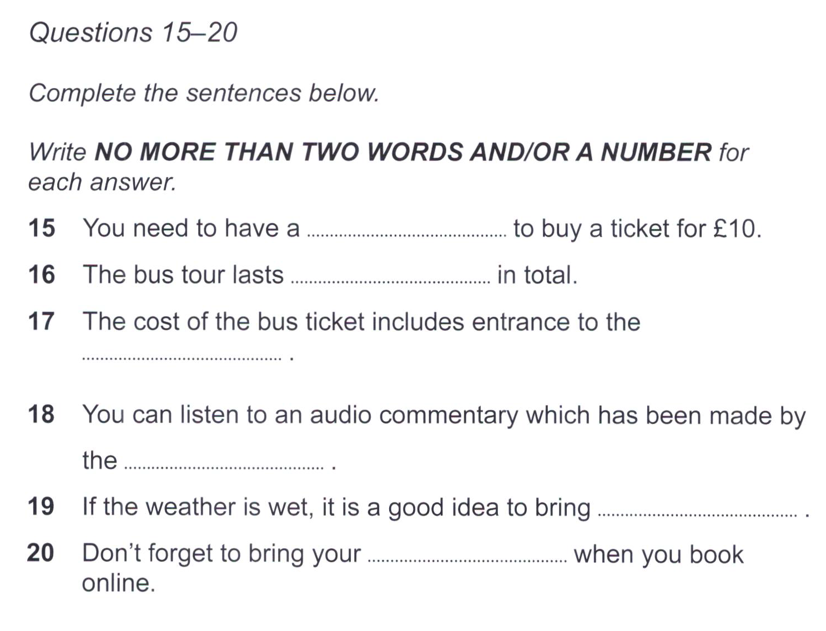
40-2
student card
fifty/50 minutes/mins
museum
tourist office
rain(-)wear/rainwear
E(-)ticket/e ticket

Slide 16
Listen for information about costs, timings, ticket and service
40-2
type | price | information
Family （F） | $30 | 2A，3C
Adult（A） | $ 15
Children（C） | $ 5 | Under 15
Student （S） | $10 | S card
Tickets include museums not others
buy
Online: print
Phone: collect
Station
stops
1st | 10 am
Last | 6 pm
interval | 30 mins
Length | 50 mins
Service
local guides but not all
Audio commentary with headphone
Easy
No charge

Slide 18
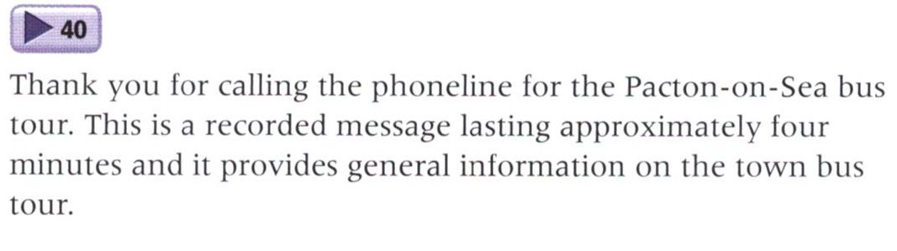
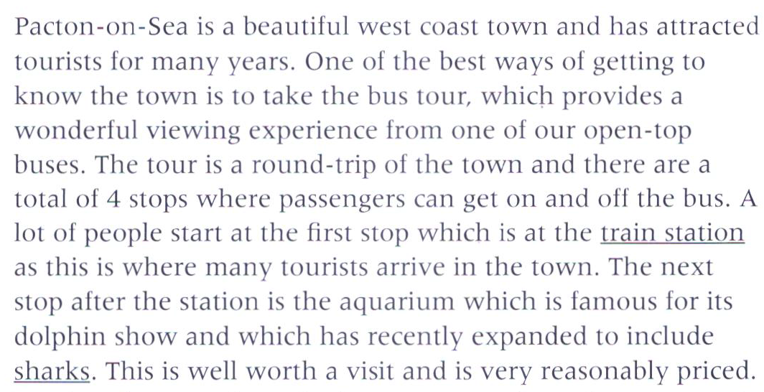
40

Slide 19
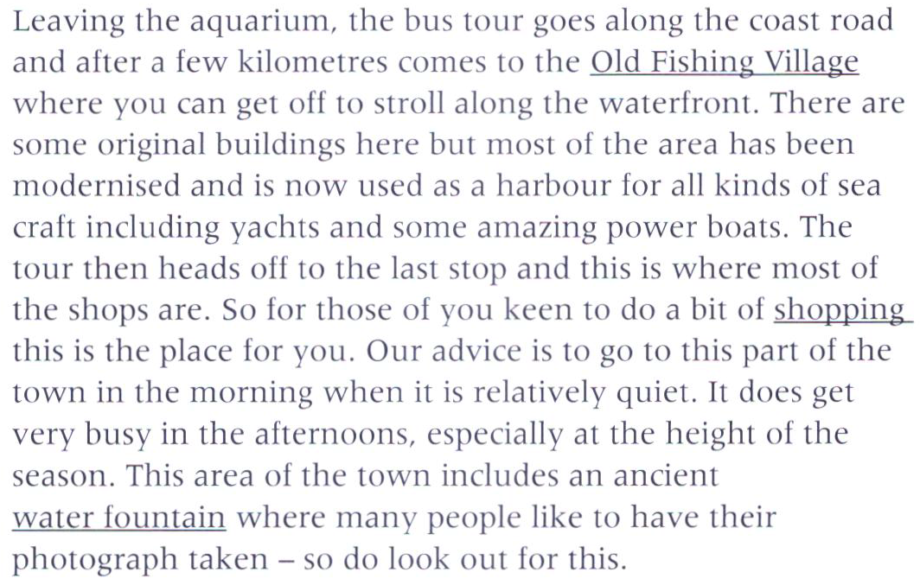

Slide 20
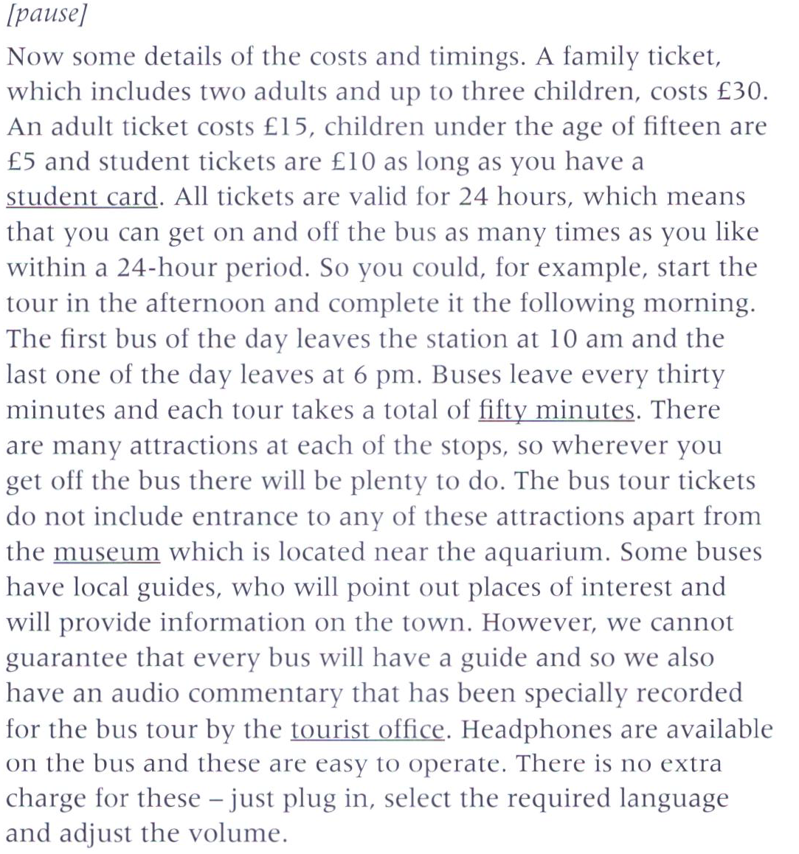

Slide 21
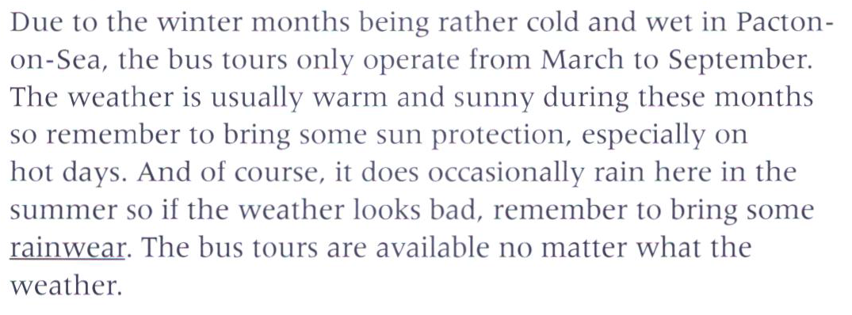
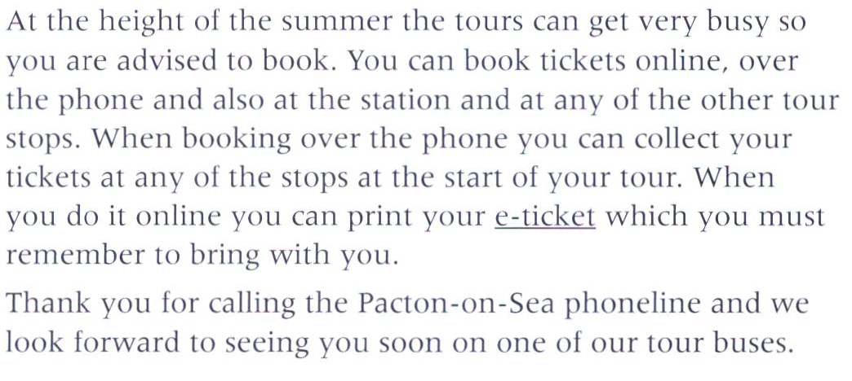

Slide 22
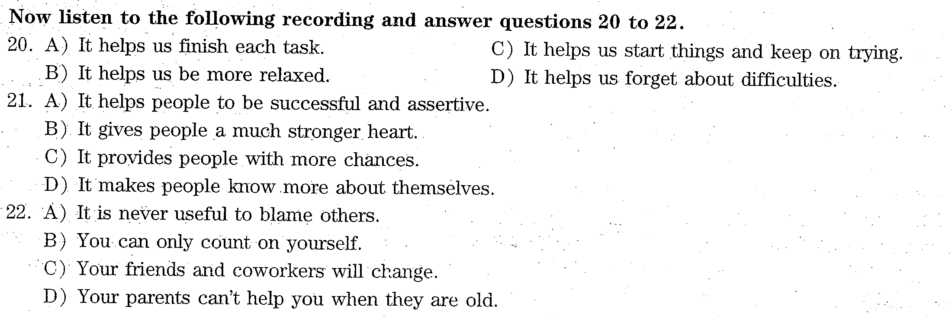
2015年6月第一套讲座2
C2

Slide 23
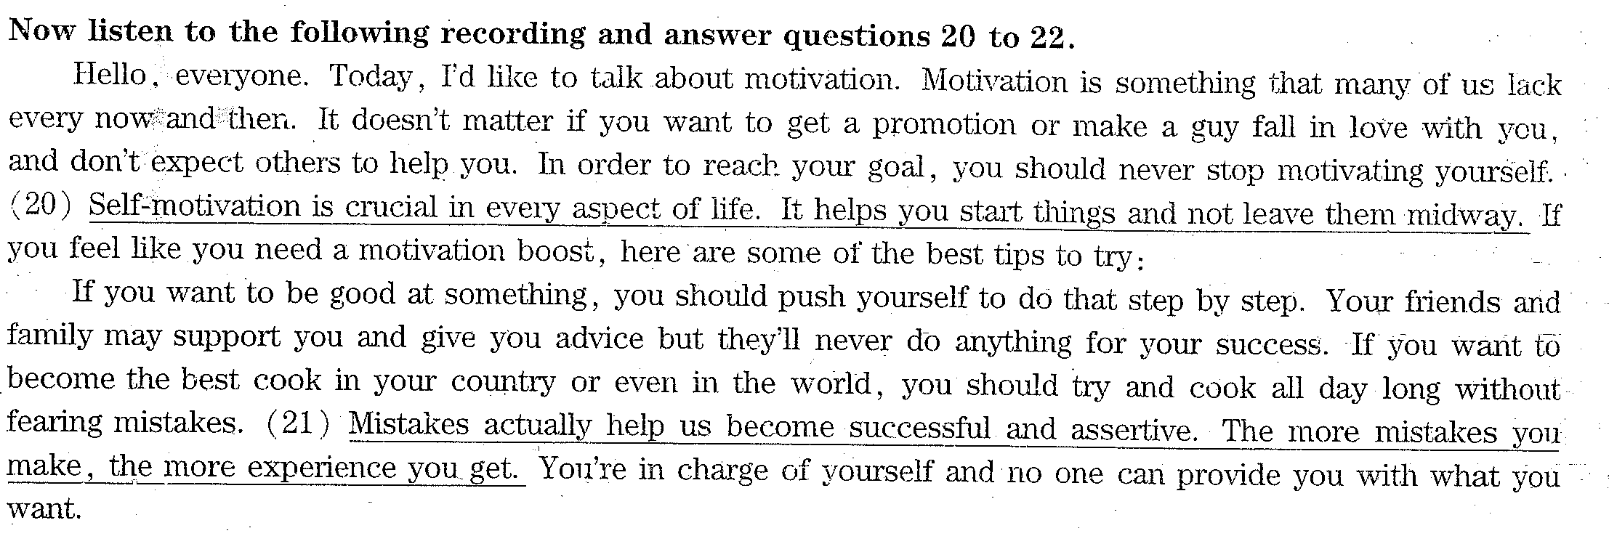
C2

Slide 24
